Slide 1
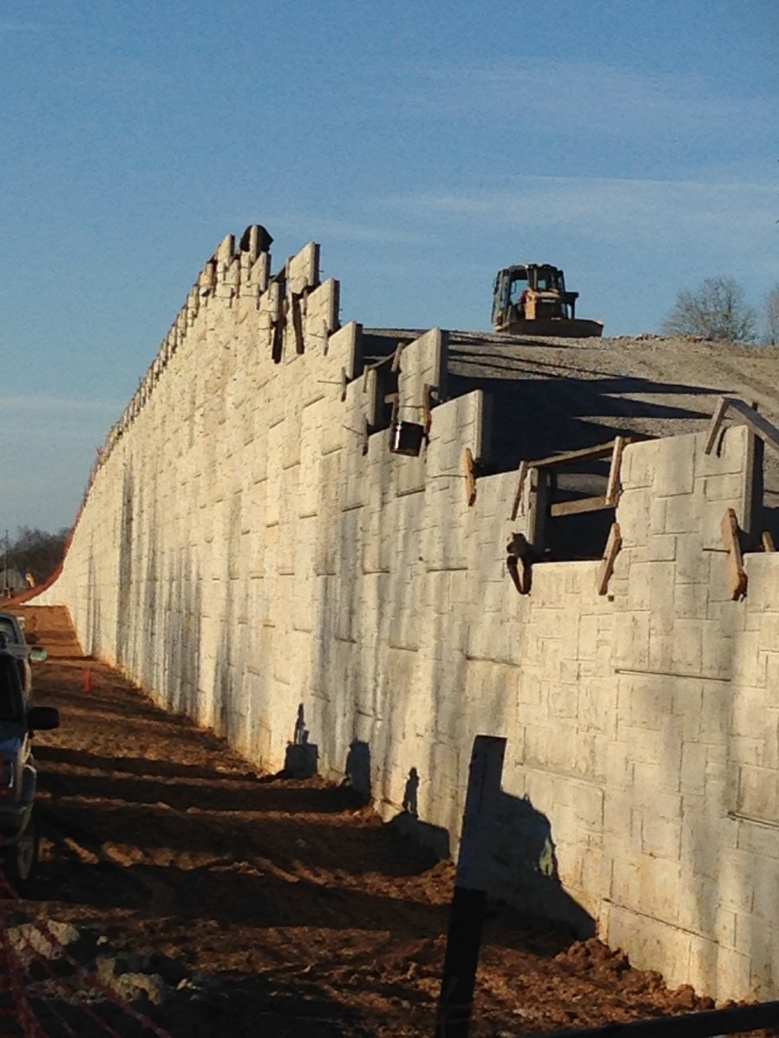

TDOT
Retaining Wall Installations
Robert Jowers, P.E.
Tennessee Department of Transportation

Slide 2
TDOT Retaining Wall Installations
Outline of Presentation
Overview of TDOT retaining wall administrative practices over past twenty years
Case study example of a rather large MSE retaining wall
Adopted policy for proprietary systems to be listed on QPL
Notes:
Brief history or summary of how we got to where we are.

Slide 3
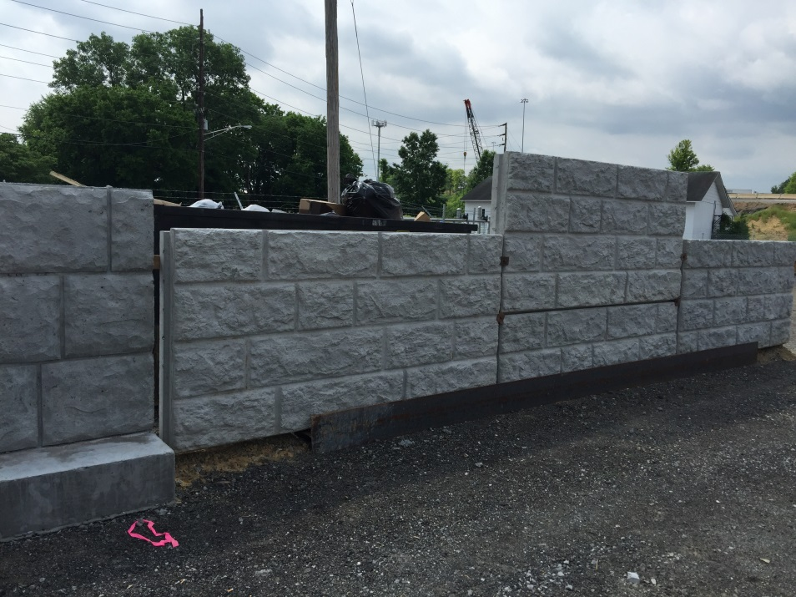
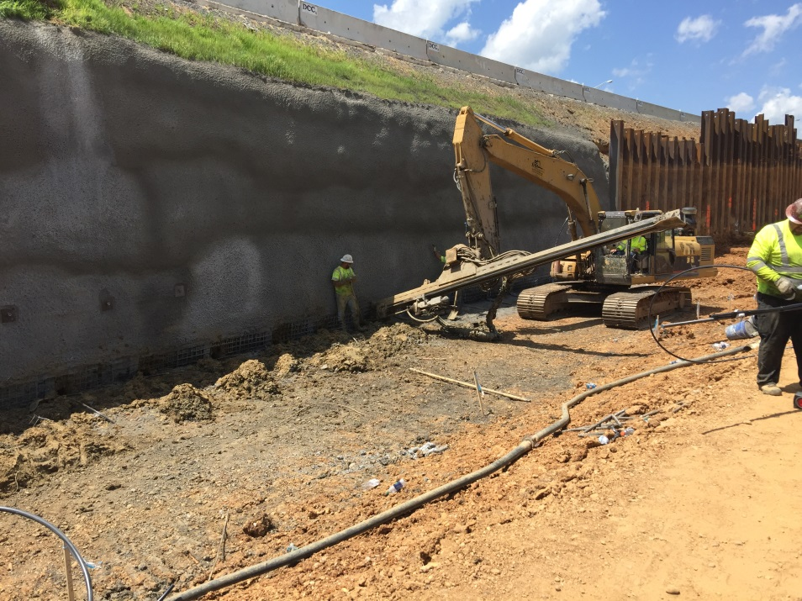
TDOT Retaining Wall Installations
Since 1999, TDOT Retaining Walls have been designed and installed by general contractors.
99% of TDOT projects are Design-Bid-Build. Proud of our CMGC jobs though.
Contractor’s bid qty is SQUARE FEET of wall face (profile)
Wall is designed by GC wall design values given in contract plans
Foundation improvements are included in the cost of the bid qty
Notes:
Brief history or summary of how we got to where we are.

Slide 4
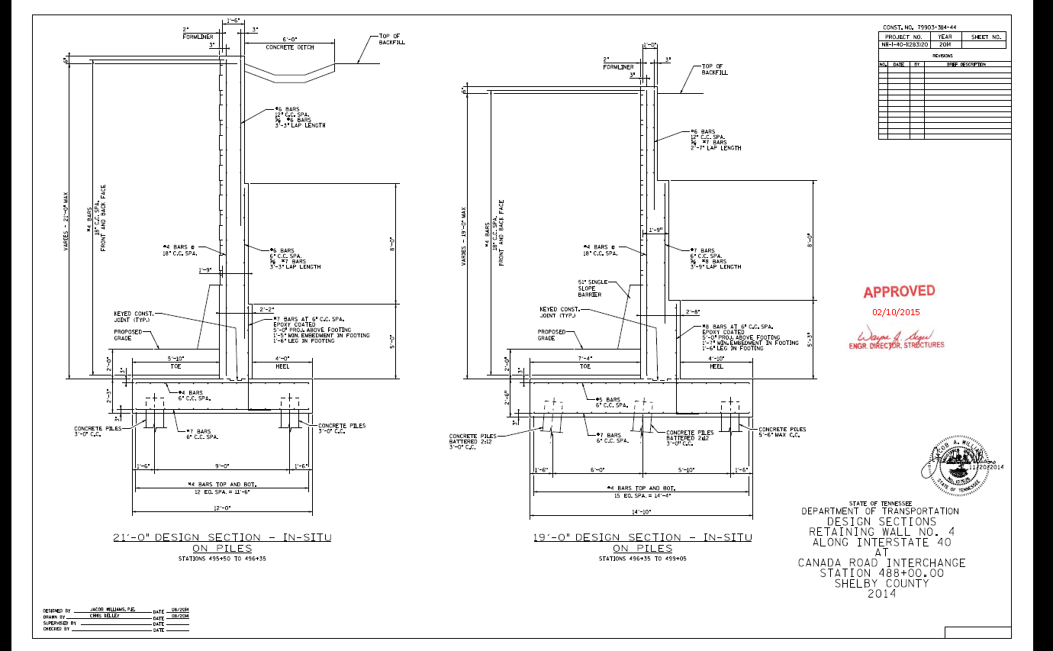
TDOT Retaining Wall Installations
Prior to 1999, most TDOT RW were typically fully designed by TDOT and included in plan sheets.
Typical design was cast-in-place, pile supported walls.
Contractors frequently requested VECP’s to install MSE walls.
FHWA recognized this as a problem. At best State not realizing savings, and at worst bid process being compromised.
Notes:
Structures Division and Geotech were preparing plans for future lettings while receiveing VECP’s for jobs that were thought to be out the door.

Slide 5
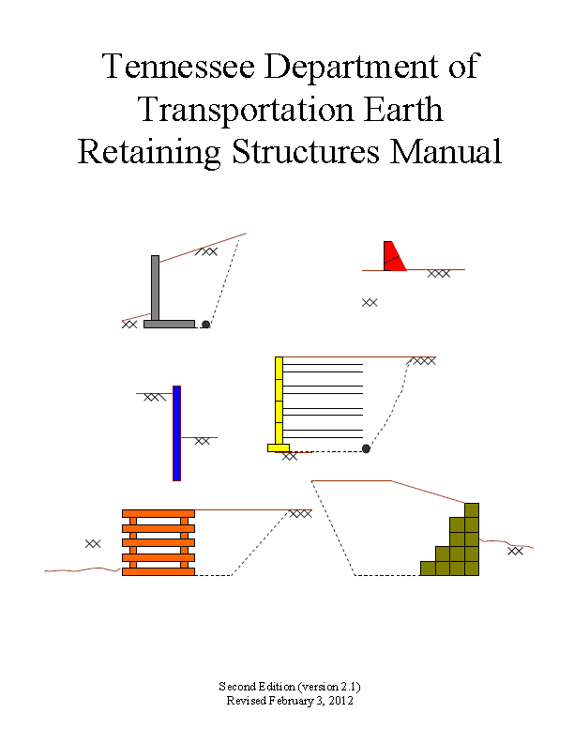
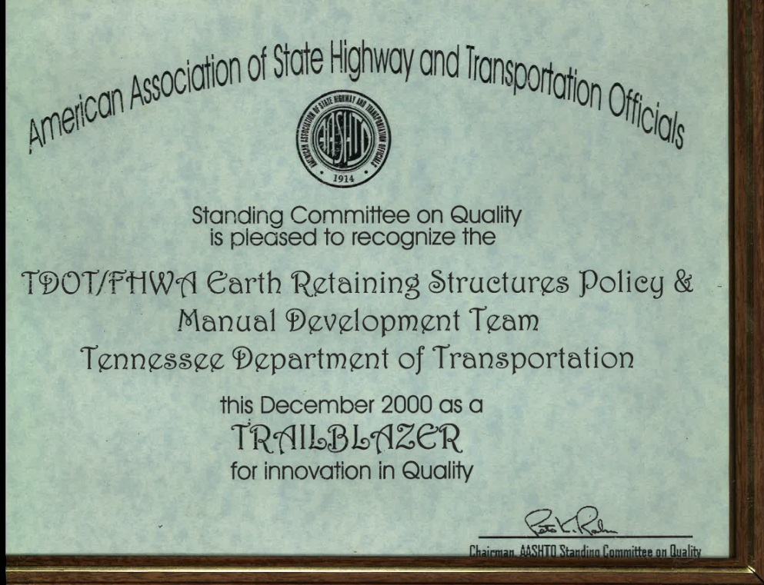
TDOT Retaining Wall Installations
1998 – TDOT \ FHWA leaders formed committee and drafted TDOT Earth Retaining Structures Manual concept
Contractors would now take on role of designing walls, not TDOT
TDOT determines “Acceptable Wall Types” based on site conditions
TDOT reviews shop drawings developed by Contractor
Notes:
We would spell out in the plans all of the work we wanted and contractors could competitively bid.

Slide 6
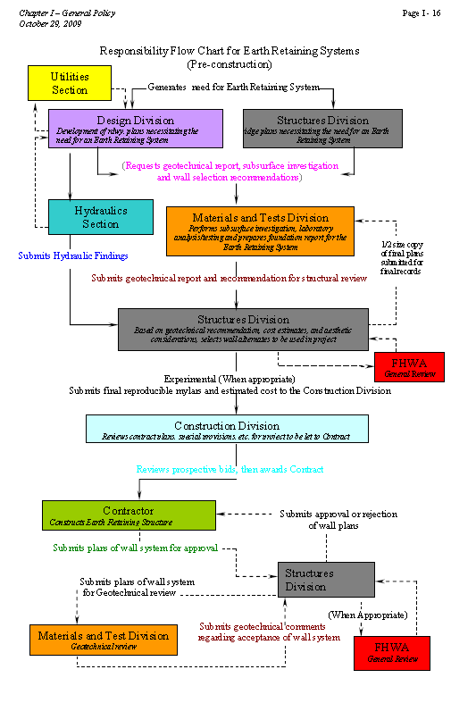
TDOT Retaining Wall Installations
2000 - TDOT Earth Retaining Structures Manual, 1st Ed.
Document immediately endorsed, little stakeholder training
Came to be known as the Retaining Wall Policy
Thorough – contained guidance for all stakeholders
Due to familiarity, many proprietary RW systems “grandfathered in”
Other proprietary RW systems required to submit HITEC evaluation to be considered for TDOT approval

Slide 7
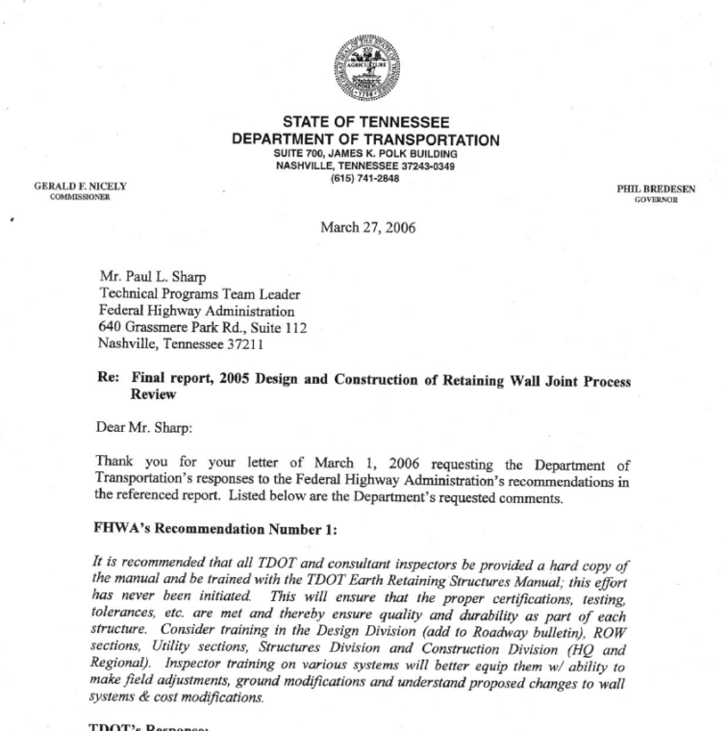
TDOT Retaining Wall Installations
2005 FHWA Ret. Wall Joint Process Review Conducted
Focus was on Ret. Wall Manual training between Divisions of R.O.W., Construction, Rdwy Design, Structures, Mat’ls & Tests-Geotech
Clearly, RW administration was
on TDOT and FHWA radar.

Slide 8
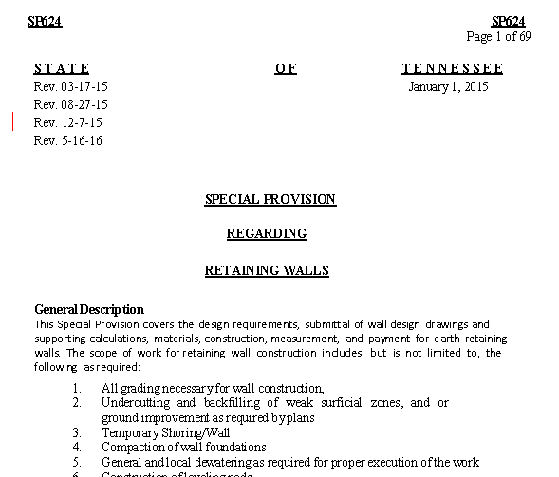

TDOT Retaining Wall Installations
Between 2005 and 2010 - SP 624 replaces Manual
Special Provision (SP) 624 Retaining Walls first developed
Geared toward RW design and installation only.
Retaining Wall Manual Chapter 1 General Policy left out purposefully
Intent was contractual \ legal. Directed toward bidding contractors
Special Provisions are binding per TDOT Standard Spec Book
Notes:
No overall guidance was given for plans development, only the end results.

Slide 9
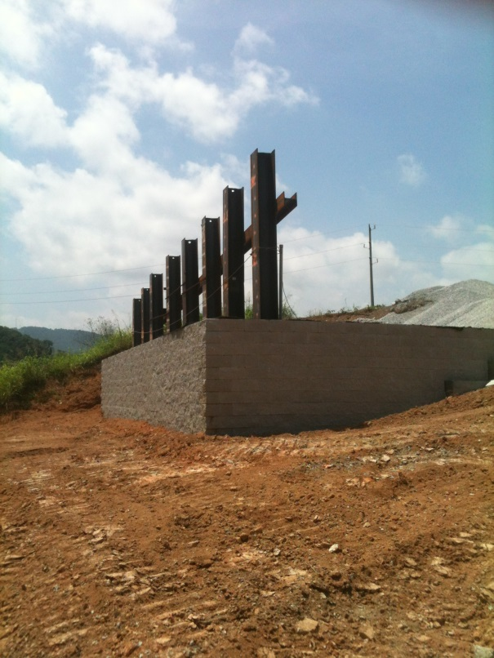
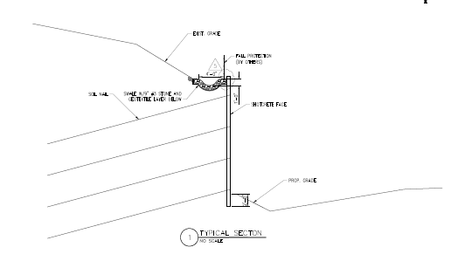
TDOT Retaining Wall Installations
SP 624 Retaining Walls
TDOT requirements for contractor wall design
Rdwy Designer uses TDOT Design Guidelines for geometric guidance
Contractor seeks Qualified Products List for pre-approved retaining wall systems
Contractor most often seeks services of retaining wall designer
Like Manual, many insiders complain the SP is too lengthy (71 pg)

Slide 10
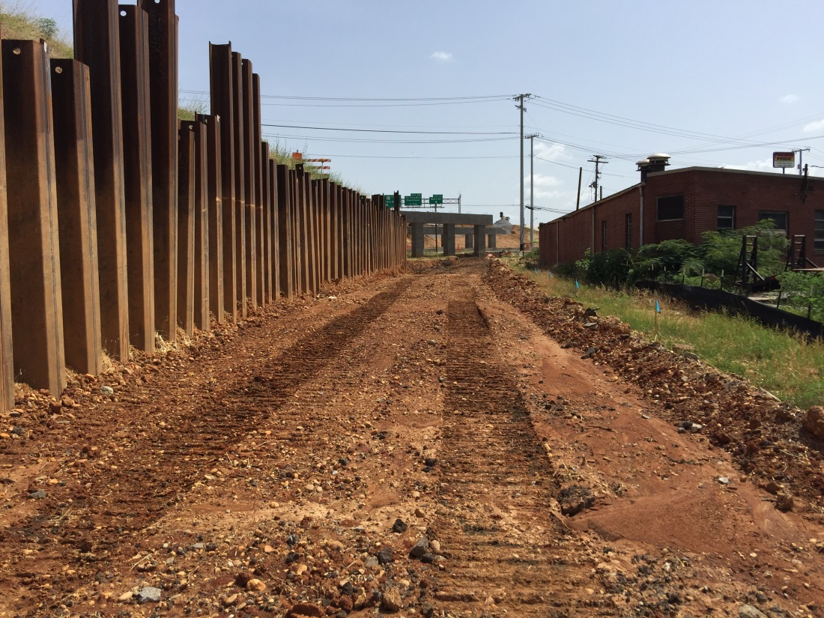
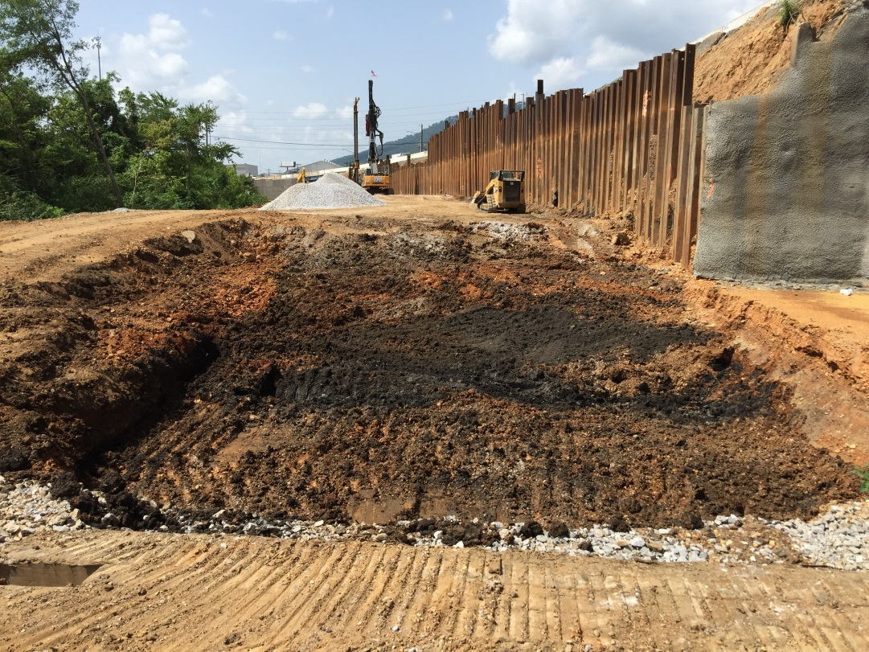
TDOT Retaining Wall Installations
Where SP624 Retaining Walls works well…
TDOT no longer designs retaining walls, for practical purposes.
TDOT only reviews contractor’s design for approval
Contractor normally has at least two alternatives to choose from.
Cater the wall design to the type work best suited to their company
Different wall types normally inject competition

Slide 11
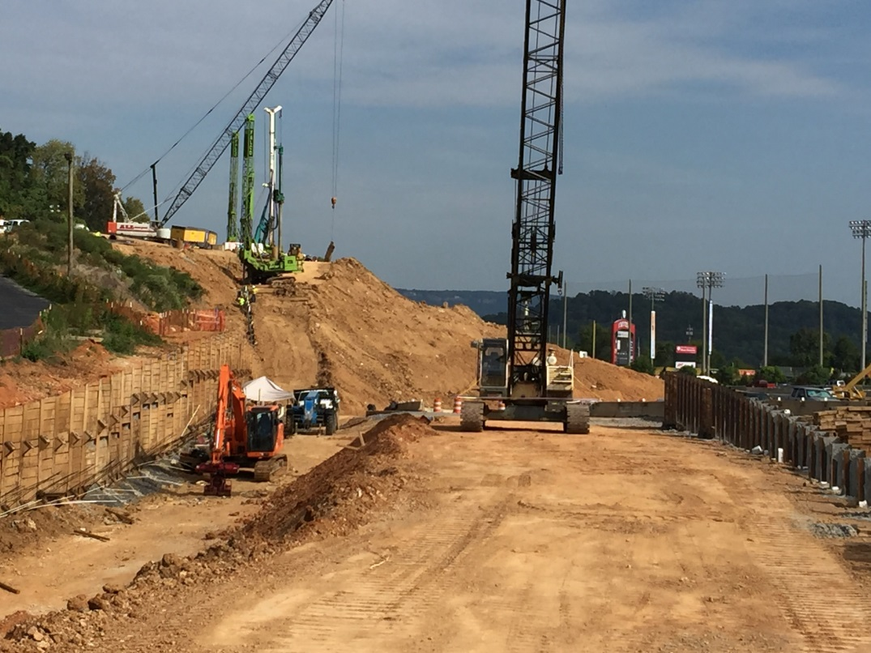
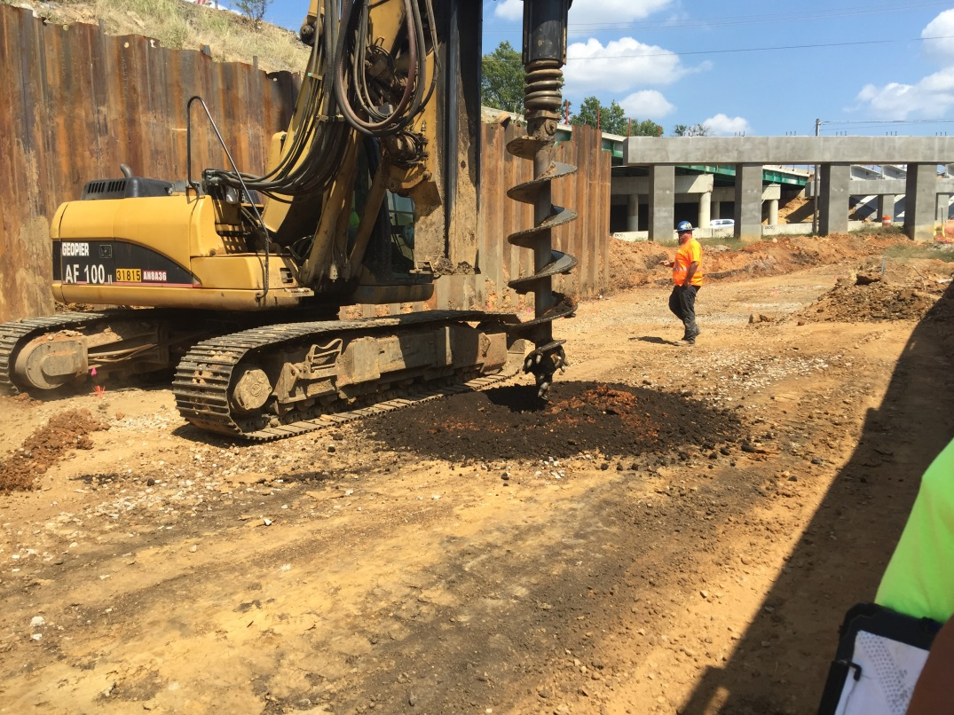
TDOT Retaining Wall Installations
SP624 Bidder Objections
All inclusive bid item qty. 604-07.01RETAINING WALL (DESCRIPTION) S.F.
Temp. shoring, foundation improvement, moment slabs all included in SF bid.
Inadequate bid estimation time window between advertisement and bid day.
Bidders object to too many Acceptable Wall Types to choose.
Bidders object to too many Foundation Improvement alternatives to choose.

Slide 12
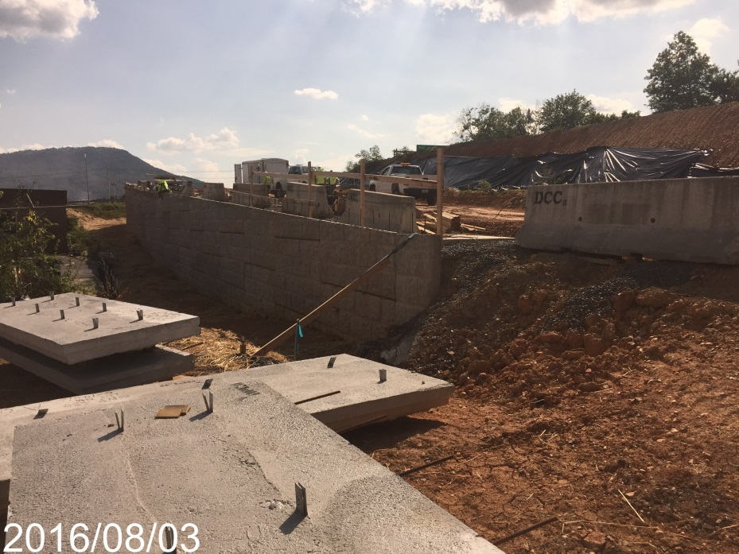
TDOT Retaining Wall Installations
How other STGEC DOT’s administer Ret. Walls
ACEC committee with TDOT Structures Division presented a document that other states policies are similar.
Notes:
When confronted with developing a guidance document of any kind I always go to South Carolina first and see what they have on the subject that I may start from.

Slide 13
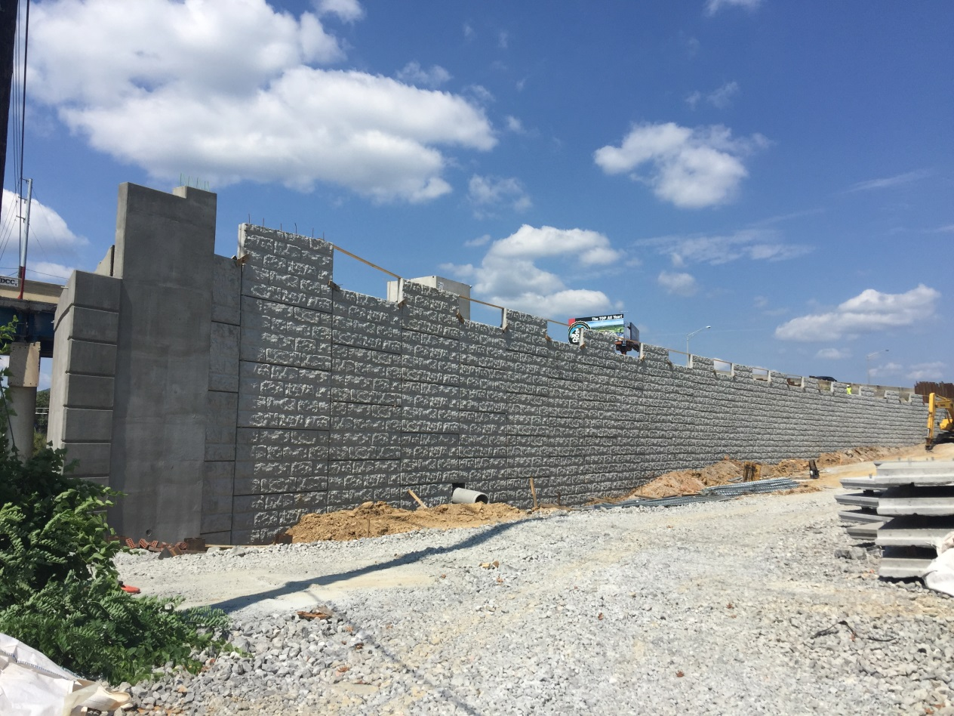
TDOT Retaining Wall Installations
TDOT Retaining Walls in Future
Most top-down constructed walls will be designed by TDOT.
The relatively simple cut walls and fill walls will continue to be administered through SP 624.

Slide 14
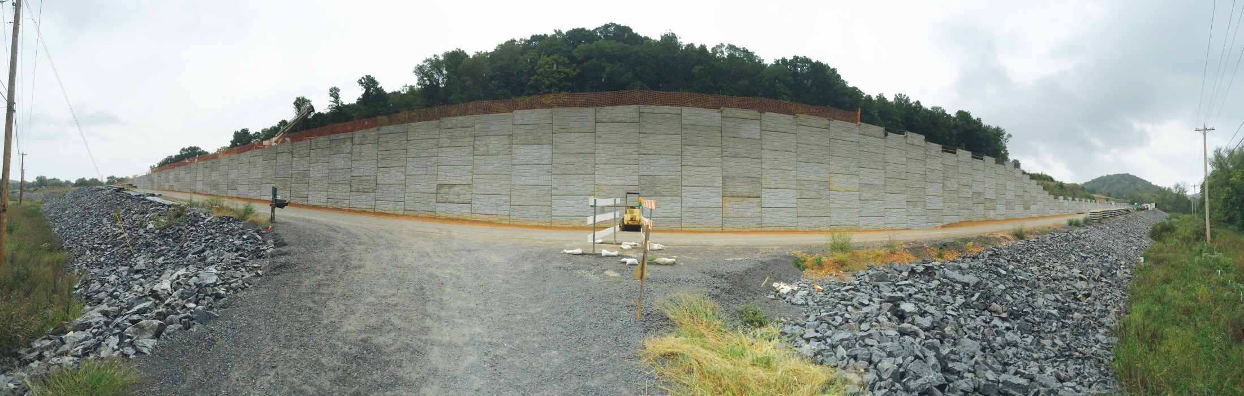
TDOT Retaining Wall Installations
Case Study Example – SR-16, Bedford Co.
Bids opened in Fall 2013
60’ Height , 80,000 SF
Environmental feature causes side hill alignment shift away from rock cut

Slide 15
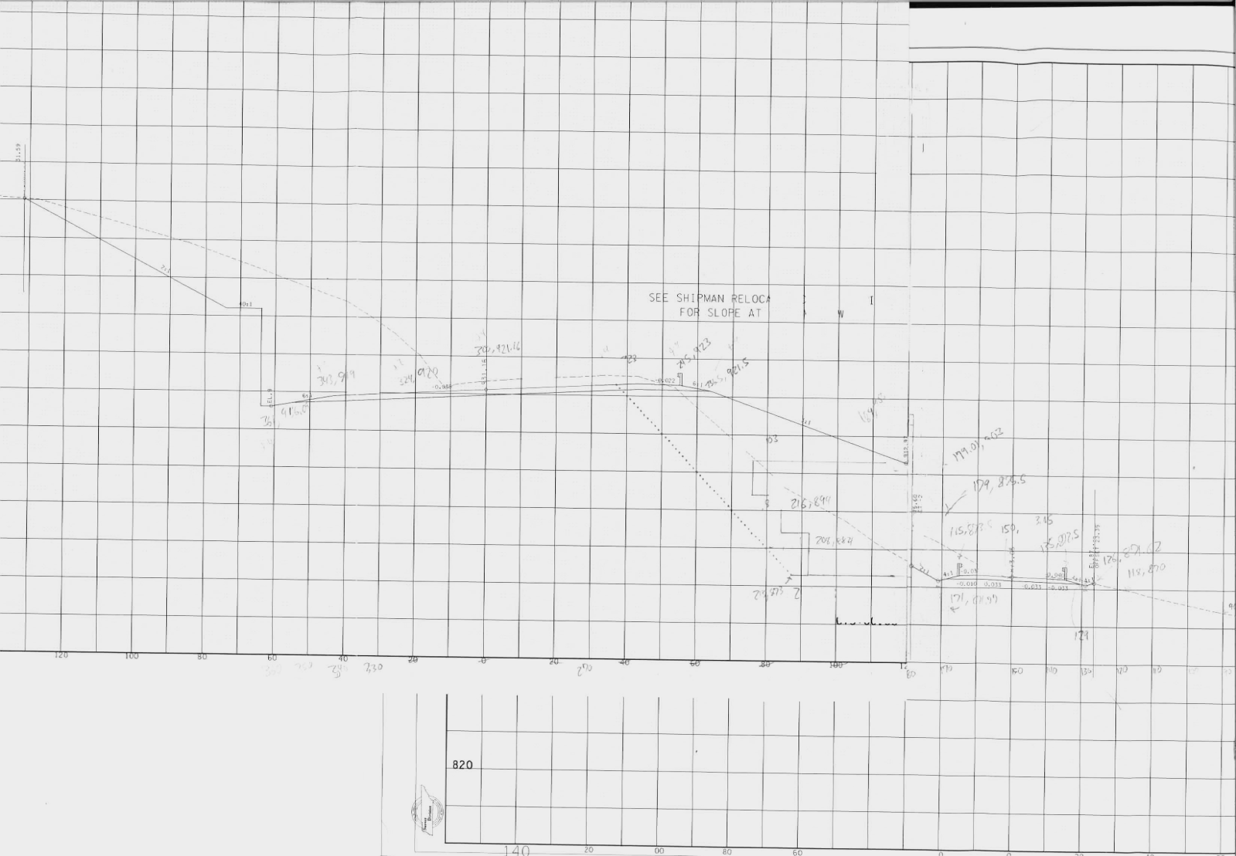
TDOT Retaining Wall Installations
Case Study Example – Alignment Shift Req’d.

Slide 16

TDOT Retaining Wall Installations
Case Study Example – Contract Contains
Conceptual Retaining Wall Drawings
Geotechnical Design Values & Notes
Typical Figures
SP624 - Retaining Walls

Slide 17
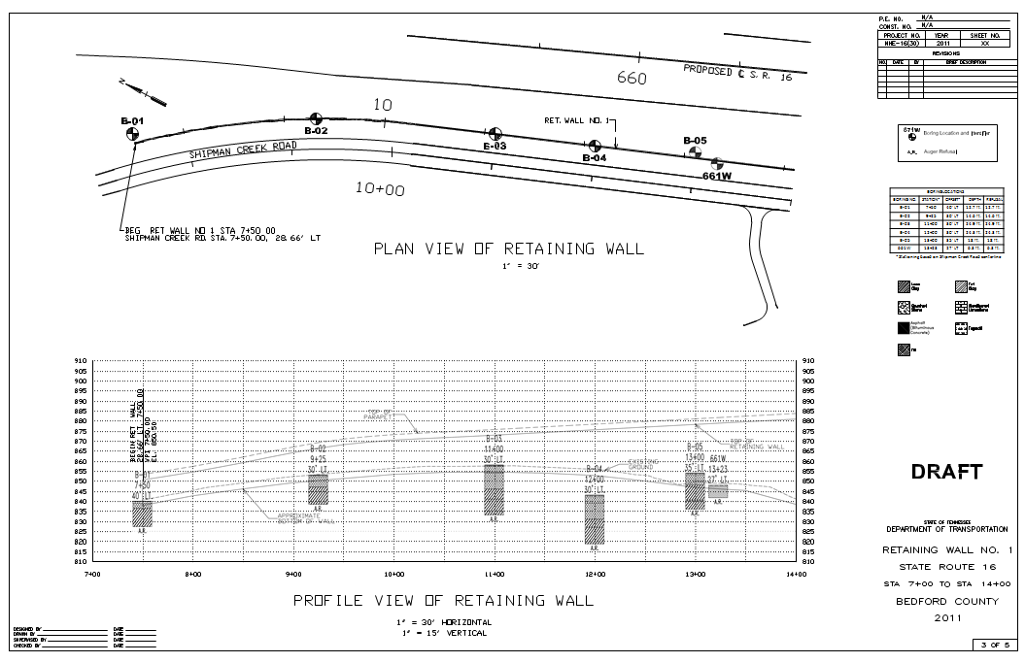
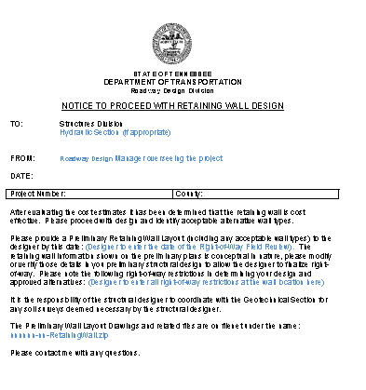
TDOT Retaining Wall Installations
Case Study Example – Conceptual Ret. Wall Dwg
Rdwy Designer’s conceptual design.
Submits to Structures Division to initiate geotechnical investigation

Slide 18
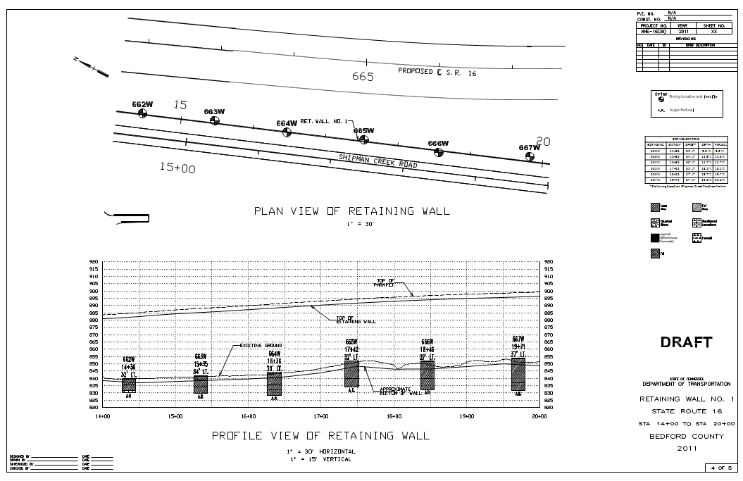
TDOT Retaining Wall Installations
Case Study Example – Geometric Conceptual Dwg
Rdwy Designer designs and delivers to Structures Division

Slide 19
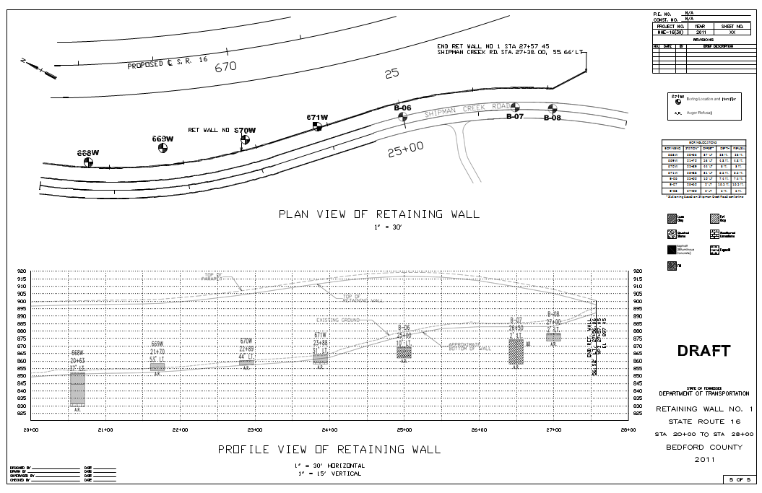
TDOT Retaining Wall Installations
Case Study Example – Geometric Conceptual Dwg
Rdwy Designer designs and delivers to Structures Division

Slide 20
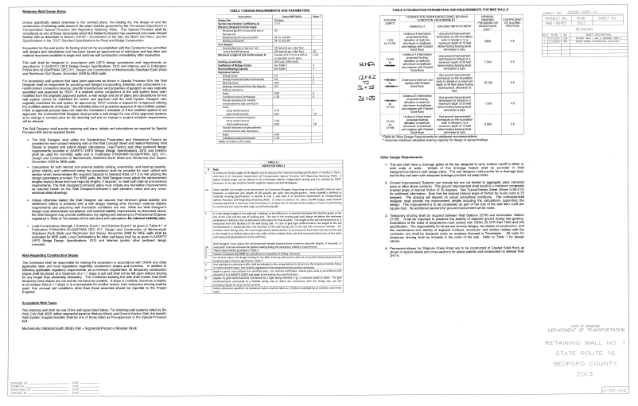
TDOT Retaining Wall Installations
Case Study Example – Geotechnical Design Values and Notes
Acceptable Wall Types
Geotechnical Design Values and LRFD Resistance Load\Factors
Foundation Improvement is evaluated and recommended
Notes are added – the shalls and shall nots

Slide 21
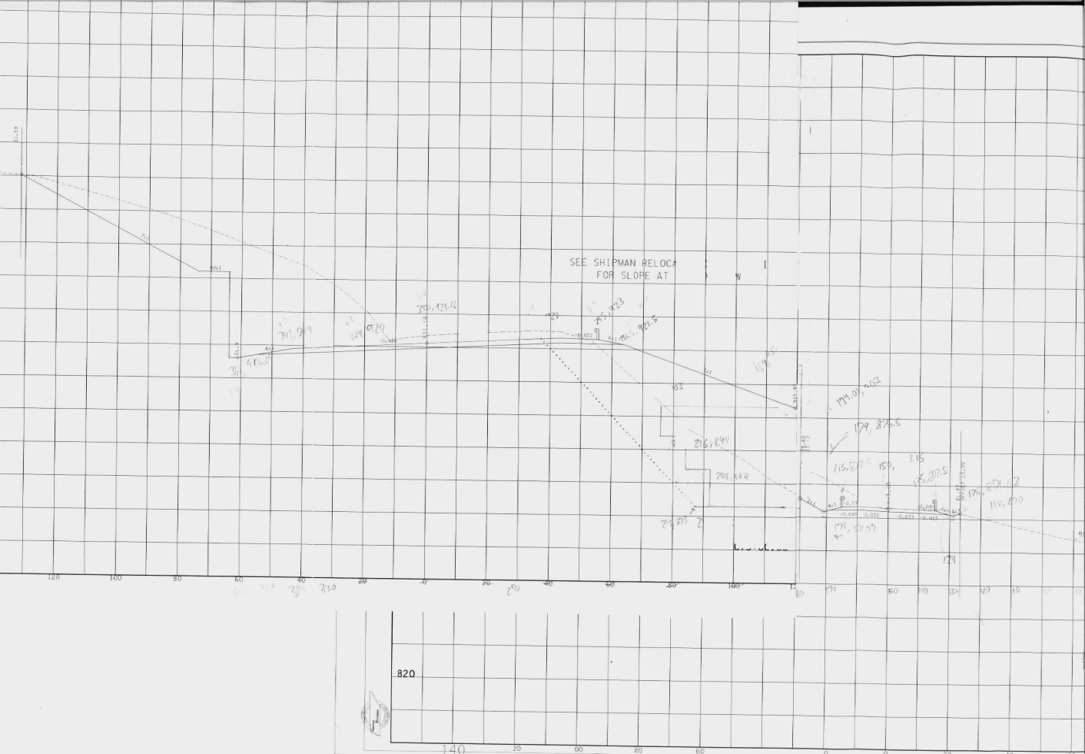
TDOT Retaining Wall Installations
Case Study Example – Geotechnical Design Values
Review prop. grade separation and consider appropriate wall types
Objective is to provide the wall designer with a building platform that is externally stable. Sliding. Global stability

Slide 22
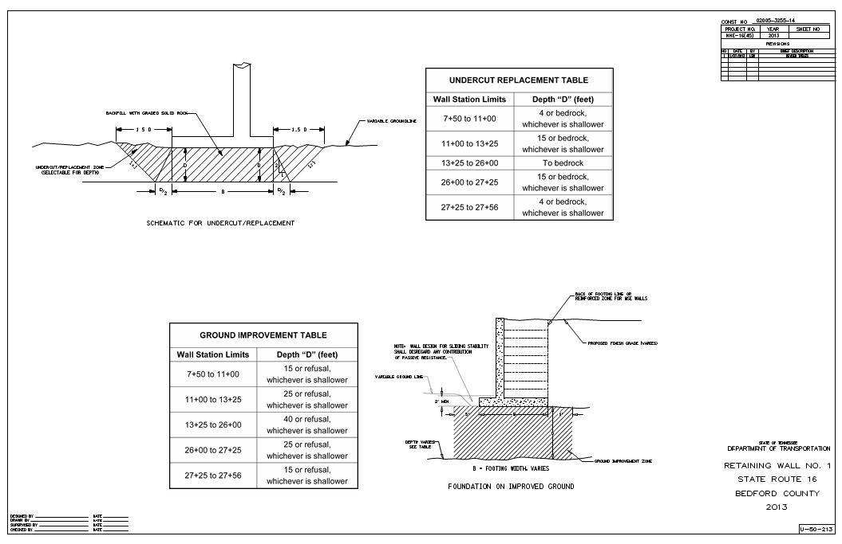
TDOT Retaining Wall Installations
Case Study Example – Typical Figures

Slide 23
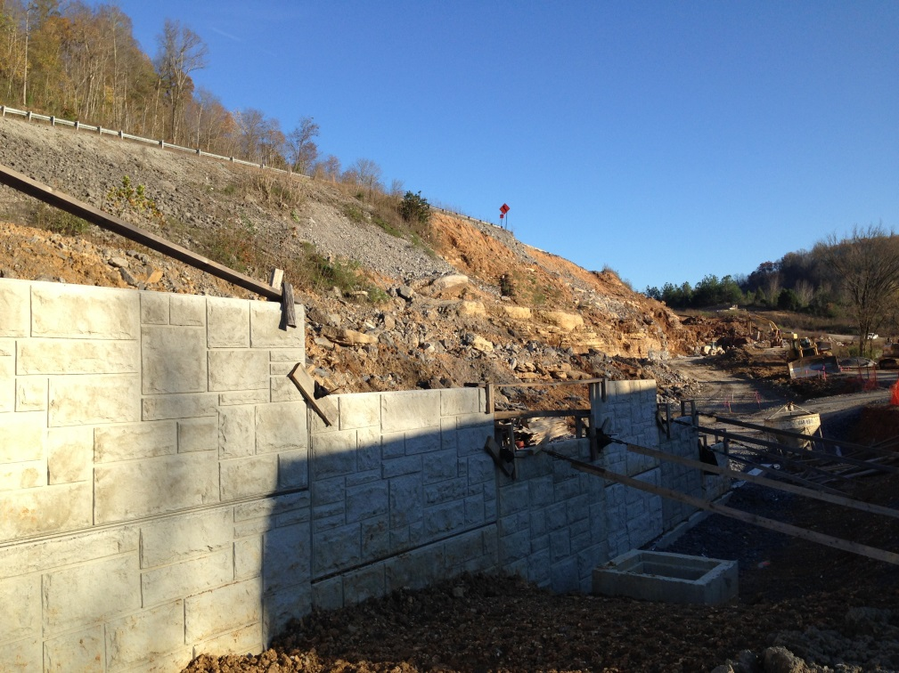
TDOT Retaining Wall Installations
Case Study Example – Bid Process
Report and Drawings delivered to Structures Division
Structures Division “Finalizes” concept plan and inserts sheets into plans
Construction Division inserts SP624 into contract book
Project advertised for letting

Slide 24
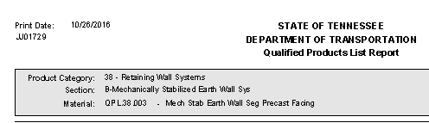
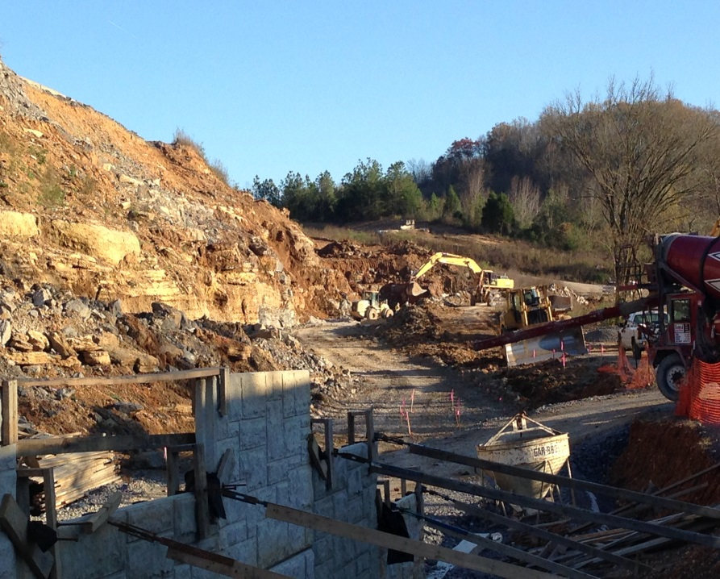
TDOT Retaining Wall Installations
Case Study Example – Bid Process
Contractors typically seek subcontractors to assist in take-off estimate.
For proprietary products (MSE systems), contractors are obligated to use pre-approved QPL list.

Slide 25
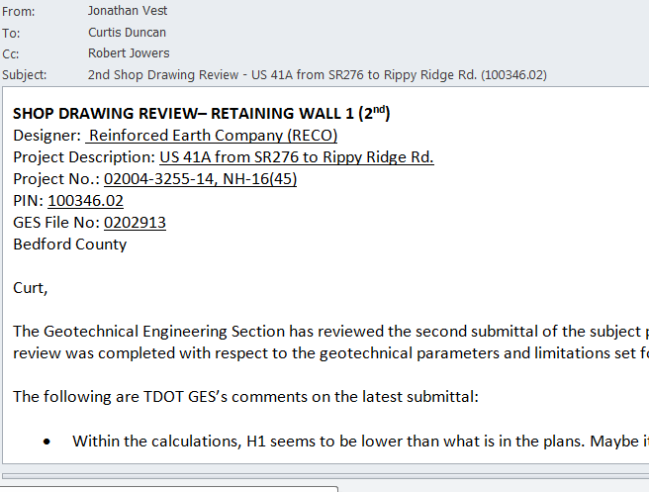
TDOT Retaining Wall Installations
Case Study Example – Contract Awarded
Contractors deliver to Structures Division retaining wall shop drawings for review and approval.
Contractor installs retaining wall

Slide 26

TDOT Retaining Wall Installations
Proprietary MSE sytems on TDOT QPL
Three options to obtain approval
HITEC report
Sumittal package with an Independent Design Review
Documented system approval from two other DOT’s that utilize equivalent acceptance procedures to options I and II.

Slide 27


TDOT Retaining Wall Installations
Questions…(?)
Thank You for supporting MDOT and STGEC 2016!

